Slide 1
Definitions of Money.
Crowther defines money as “anything that is generally acceptable as means of exchange and at the same time acts as measure and store of value”
F A Walker defines “money is what money does”

Slide 2
Functions of Money:
A. Primary Functions:
1. Medium of Exchange:
Money serve as medium of exchange or medium of payments. Money is used as a medium through which people exchange their goods and services. It facilitates buying and selling of goods and services
2. Measure of Value:
With the help of money, it is easy to compare the relative values of commodities and services. The value of all goods and services is expressed in terms of money is called price.

Slide 3
B. Secondary Functions:
1. Standard of Deferred Payments:
In a money economy, we can buy goods and services without making immediate payments. Payments could be made at a future date.
2. Store of Value:
Goods cannot be stored for a long time. Hence, money helps to store the surplus income, savings or wealth in the form of money for longer duration

Slide 4
4. Imparts liquidity and Uniformity to wealth.
All forms wealth of can be converted into money. Thus, money gives liquidity to various forms of wealth. Hence money imparts uniformity to wealth.
Demand for Money
The demand for money refers to the desire to hold cash. Money can be used for any purpose immediately and hence people desire to hold money either as cash or in the form of readily withdrawable demand deposits in banks.

Slide 5
Shape of Md
Md slopes down as the interest rate increases the demand for money decreases.
Md shifts right if income/ prices increases.
r
Md
Md

Slide 6
Determinants of the Demand for Money:
The demand for money is affected by several factors like the level of income, interest rates, and technological changes, etc.
three motives for holding money are
1. Transaction Demand for Money:
It means the money we need to purchase goods and services in day to day life.

Slide 7
2. Precautionary demand for Money:
it means the money we may need for unexpected purchases or emergencies. Unexpected expenses such as medical bills, unemployment, accident repair bills etc.
3. Speculative Demand for Money:
The speculative motive implies the desire of the public to keep a certain amount of cash to make speculative gains out of the purchase and sale of securities ( bonds and equities) through future changes in the rate of interest

Slide 8
The supply of Money:
The term ‘supply of money’ means the aggregate stock of domestic money held by the public in a country.
Money supply is exogenously controlled and fixed by the central bank of the country.

Slide 9
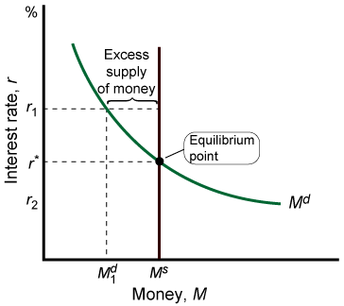
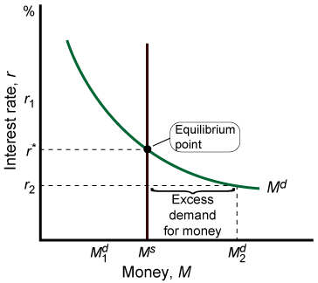
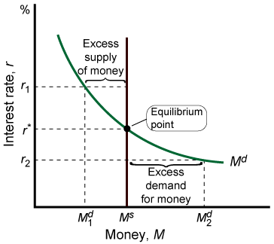
The Equilibrium Interest Rate
R (staric) is equilibrium interest rate
At r (staric) the Md and MS are equal
At r₂ there is an excess demand for money so interest rate increases
At r1 there is an excess supply of money so interest rate decreases.

Slide 10
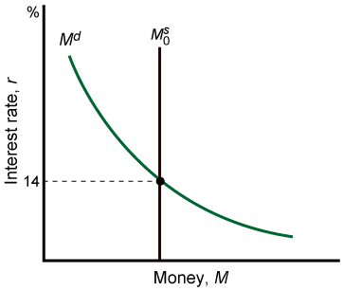
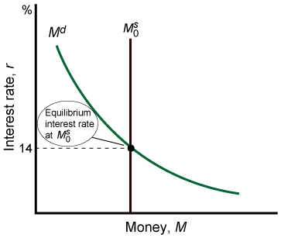
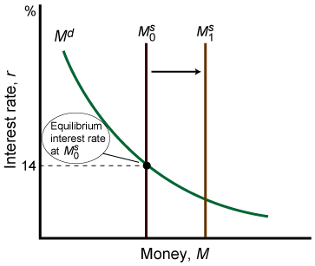
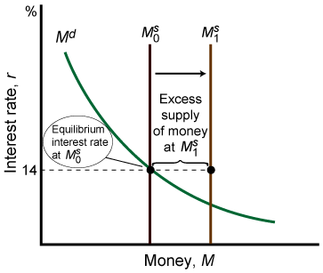
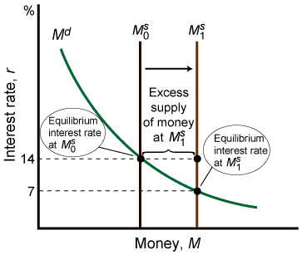
Changing the Money Supply to Affect the Interest Rate
An increase in the supply of money shifts the MS curve rightwards and it lowers the rate of interest.

Slide 11
Monetary and Fiscal Policy
The Monetary Policy controls the inflation or deflation in any economy by changing money supply and interest rate.
The Monetary Policy aims to maintain price stability, full employment and economic growth.
Tools of monetary policy
Interest rate and money supply

Slide 12
MONETARY POLICY INSTRUMENTS that are used to influence money supply and interest rate
1. Bank Rate of Interest
2. Cash Reserve Ratio
3.Open market Operations
4. Marginal ratio Requirements
5. Credit Control etc.

Slide 13
Fiscal Policy
fiscal policy is a broader tool of the government.
The Fiscal Policy can be used to overcome recession and control inflation.
Fiscal policy is defined as a change in government revenues and expenditures to influence the level of national output and prices.
Tools of fiscal policy
1. Reduction of Govt. Expenditure
2. Increase in Taxation
3. Provision of Subsidies

